Slide 1
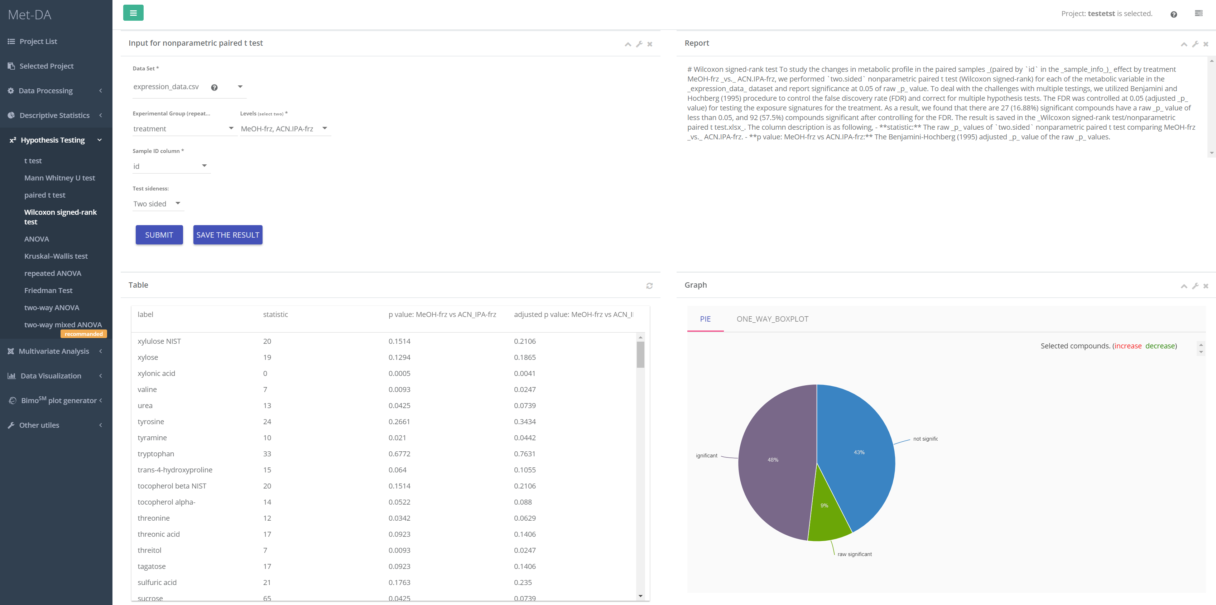
1
4
3
2

Slide 2
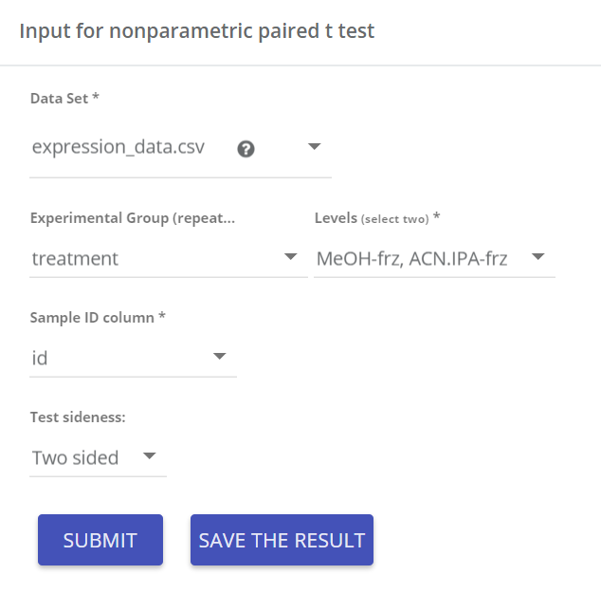
Input parameters
Data matrix for Wilcoxon-Signed Rank test
Select two groups you would like to test
Sample id is required for paired/repeated measure study to tell which columns of data are measured from same sample. OR how are samples paired.
Test either MeOH-frz ≠ ACN.IPA-frz , or MeOH-frz < ACN.IPA-frz, or MeOH-frz > ACN.IPA-frz
1

Slide 3
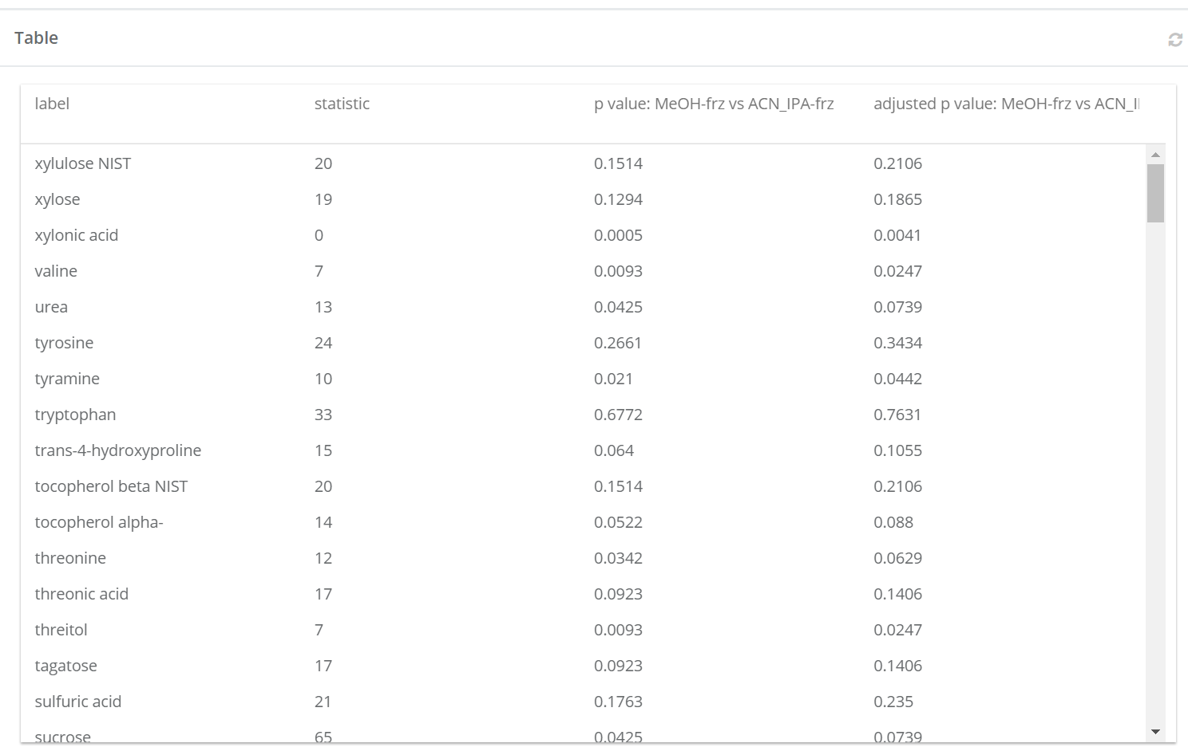
Result table
statistic:
Nonparametric paired t test, Wilcoxon-Signed Rank test does not have positive and negative statistic.
p value: MeOH-frz vs ACN.IPA-frz:
p value of Wilcoxon-Signed Rank test
2
adjusted p value: MeOH-frz vs ACN.IPA-frz:
p value of Wilcoxon-Signed Rank test adjusted for false discovery rate using Bonjamini-Hochberg correction. Adjusted p value is always larger than the p value.

Slide 4
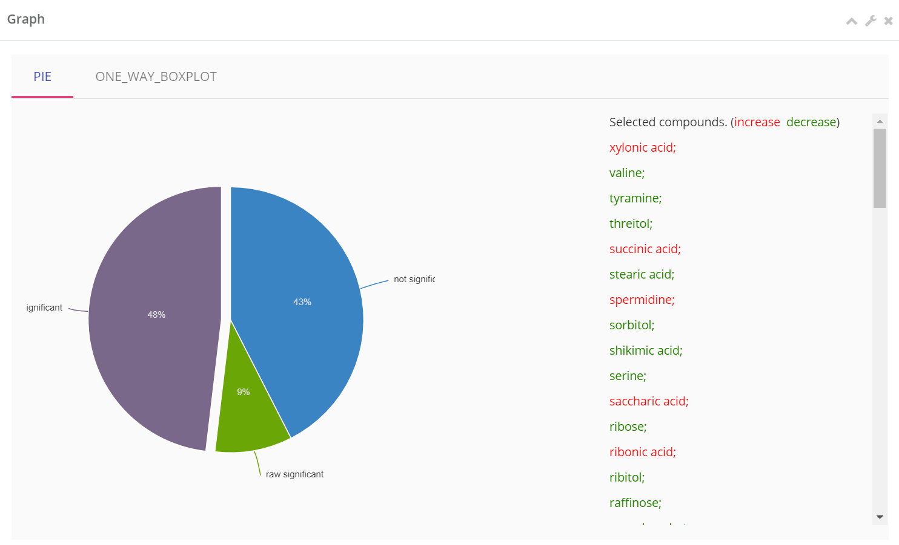
Visualizing the significant percentage
Pie chart visualization of the percentage of significant compounds.
Not significant: p value > 0.05
Raw significant: p value < 0.05 but adjusted p value > 0.05
FDR significant: adjusted p value < 0.05
Click arc to display the compound names in each arc. increase means MeOH-frz is larger than ACN.IPA-frz.
3

Slide 5
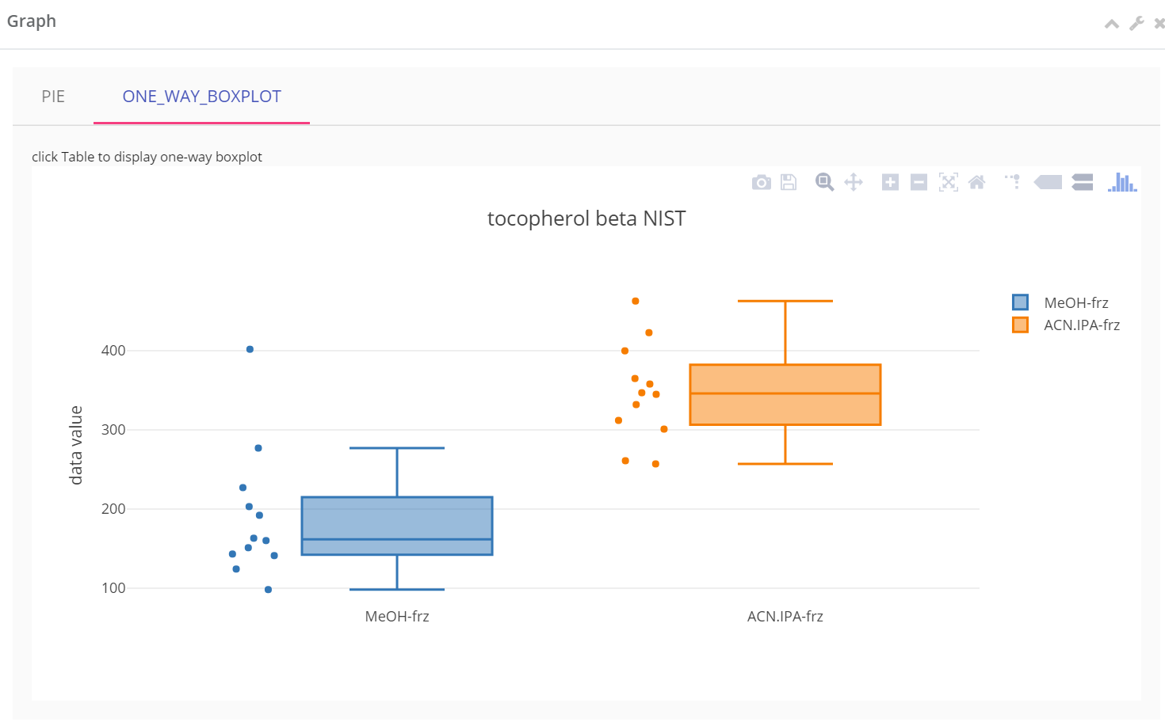
Visualizing each compound using boxplot
Click result table row to visualize each compound by boxplot.
Scatters next to boxplots are the sample values.
Boxplots for all the compounds can be generated/saved in Visualization->Boxplot.
4

